Slide 1
Sensitivity and Specificity: A Model Accuracy Checker
Statistics - CSD4101 – CE II
F.Y. MSc. Data Science (2022-23)
Presented by:- Shameek Bhowmick (226524) & Aliasgar Saria (226503)

Slide 2

The W Questions
What do we mean by the terms Specificity & Sensitivity in Statistics?
Why and when do we use them?

Slide 3
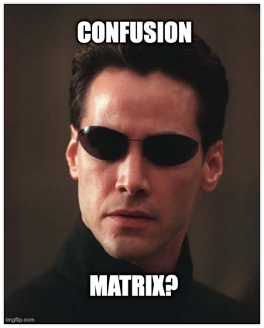
Confusion Matrix
A confusion matrix is an N x N matrix used for evaluating the performance of a classification model, where N is the number of target classes.
In layman's terms, a confusion matrix tells us what the ML algorithm or in fact any model did right, and what it did wrong.
A confusion matrix is given as :-
Predicted | Actual Status
 | Positive | Negative
Positive | TP: Actual Positive and predicted is also Positive | FP: Actual Negative and predicted is Positive
Negative | FN: Actual Positive and predicted is Negative. | TN: Actual Negative and predicted is also Negative.

Slide 4
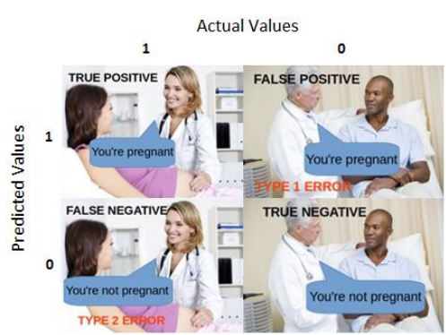
The following 4 are the basic terminology which will help us in determining the metrics we look for.
True Positives (TP): When the actual value is Positive and predicted is also Positive.
True Negatives (TN): When the actual value is Negative and prediction is also Negative.
False Positives (FP): When the actual is Negative, but prediction is Positive. Type 1 error.
False Negatives (FN): When the actual is Positive, but the prediction is Negative. Type 2 error.
Predicted | Actual Status
 | Positive | Negative
Positive | TP: Actual Positive and predicted is also Positive | FP: Actual Negative and predicted is Positive
Negative | FN: Actual Positive and predicted is Negative. | TN: Actual Negative and predicted is also Negative.

Slide 5
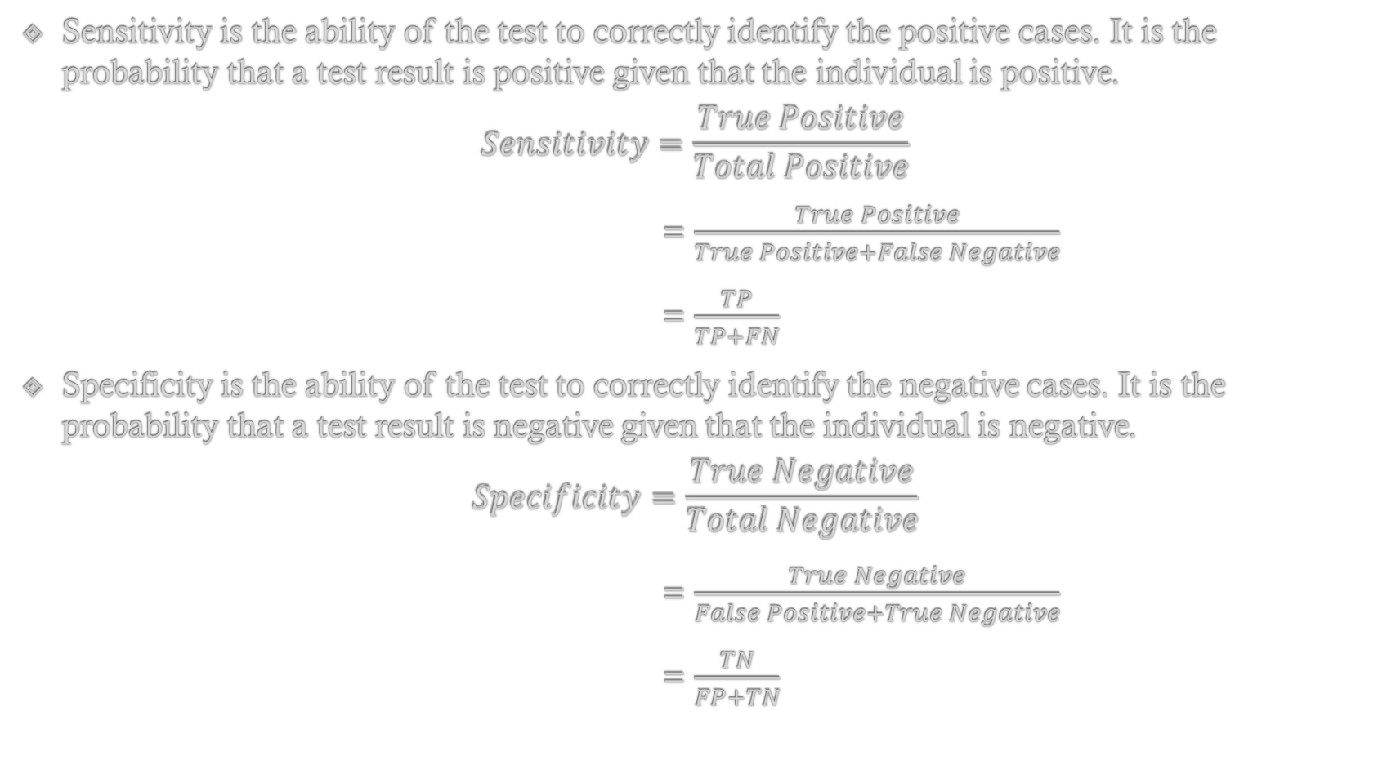
Sensitivity and Specificity
Sensitivity is the ability of the test to correctly identify the positive cases. It is the probability that a test result is positive given that the individual is positive.
$$Sensitivity=\frac{True Positive}{Total Positive}$$
= $\frac{True Positive}{True Positive+False Negative}$
= $\frac{TP}{TP+FN}$
Specificity is the ability of the test to correctly identify the negative cases. It is the probability that a test result is negative given that the individual is negative.
$$Specificity=\frac{True Negative}{Total Negative}$$
= $\frac{True Negative}{False Positive+True Negative}$
= $\frac{TN}{FP+TN}$

Slide 6


A small use case example: Email Spam
In this use case, when an email is a spam and the model predicts it to be spam, then it is a True Positive (TP). Also when an email is not a spam and the model predicts it not to be a spam, then it is a True Negative (TN).
If the sensitivity is high, it means the model is good at predicting the true spam emails correctly. On the other hand, if the sensitivity is low then the model will mark spam emails as non-spam emails because it implies that the true positive rate is low. As a result, we will end up getting more spams emails in our inbox.
Furthermore, if the specificity is high it means the true negative rate is high and as a result, the model is good at identifying non-spam emails correctly. On the other hand, if the specificity is low then the model can falsely classify a non-spam email as a spam email and as a result, we will end up losing a valuable email to our spam folder.
In this use case, it is better to have higher specificity than sensitivity because we don’t want to fill our inbox with spam mails or lose a valuable non-spam email as spam.

Slide 7
Application: Checking model accuracy using Sensitivity and Specificity

Slide 8

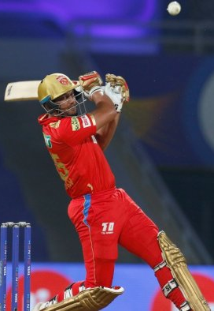
Getting to know the Data
Objective:- To check the accuracy of a regression model using Sensitivity and Specificity
Model aim:- To predict the Match Outcome (Won/Lost) based on the Match Location (Home/Away) and Toss Outcome (Won/Lost)
Data:-
We collected data of the 3 variables mentioned above of IPL winning teams of each season.
This is to maintain independency between data points as picking all the teams in each season would result in data redundancy.
Picking only the winning teams would keep the results consistent as for each season only the best team is being considered.
Matches outside of India as well as knockout stages have not been considered as the match location is variable which defeats our purpose.
Matches ending in Draws/Ties/No Result were also not considered.

Slide 9

The summary of the data collected is given below:-
Season | Champion Team | Home Matches Won / Home Matches Played |  | Away Matches Won / Away Matches Played | Tosses Won/ Matches Played
2008 | Rajasthan Royals | 7/7 | 4/7 |  | 10/14
2010 | Chennai Super Kings | 4/7 | 3/7 |  | 8/14
2011 | Chennai Super Kings | 7/7 | 2/7 |  | 7/14
2012* | Kolkata Knight Riders | 3/7 | 7/8 |  | 6/15
2013# | Mumbai Indians | 8/8 | 3/8 |  | 11/15
2015 | Mumbai Indians | 4/7 | 4/7 |  | 6/14
2016 | Sunrisers Hyderabad | 4/7 | 4/7 |  | 8/14
2017 | Mumbai Indians | 5/7 | 5/7 |  | 8/14
2018 | Chennai Super Kings | 6/7 | 3/7 |  | 10/14
2019 | Mumbai Indians | 5/7 | 4/7 |  | 8/14
Total |  | 53/71 | 39/72 |  | 82/143
*in the 2012 season, one of KKR’s home game were abandoned due to rain. And this is the only season where we see that a champion team has a far better performance record in away games than home.
#the season 2013 had 10 teams in IPL, and a different format which resulted 8 home games and 8 away games for every team.

Slide 10

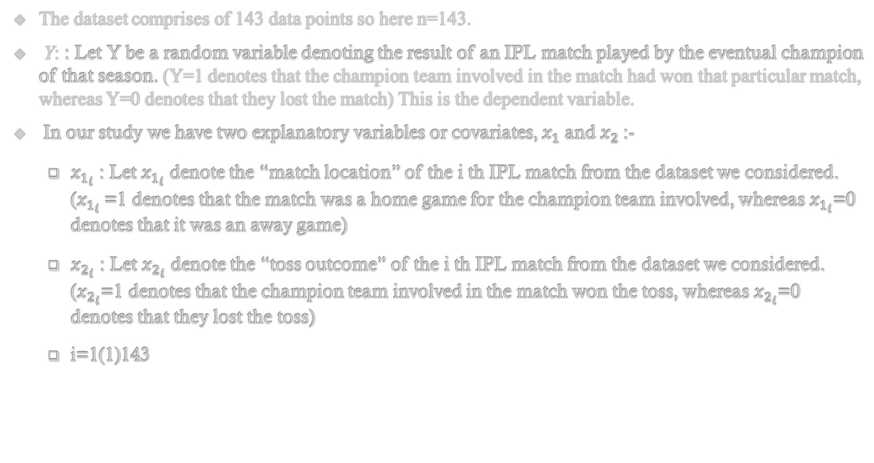
The dataset comprises of 143 data points so here n=143.
Y: : Let Y be a random variable denoting the result of an IPL match played by the eventual champion of that season. (Y=1 denotes that the champion team involved in the match had won that particular match, whereas Y=0 denotes that they lost the match) This is the dependent variable.
In our study we have two explanatory variables or covariates, $x_{1}$and $x_{2}$:-
$x_{1_{i}}$ : Let $x_{1_{i}}$ denote the “match location” of the i th IPL match from the dataset we considered. ($x_{1_{i}}$=1 denotes that the match was a home game for the champion team involved, whereas $x_{1_{i}}$=0 denotes that it was an away game)
$x_{2_{i}}$ : Let $x_{2_{i}}$ denote the “toss outcome” of the i th IPL match from the dataset we considered. ($x_{2_{i}}$=1 denotes that the champion team involved in the match won the toss, whereas $x_{2_{i}}$=0 denotes that they lost the toss)
i=1(1)143

Slide 11
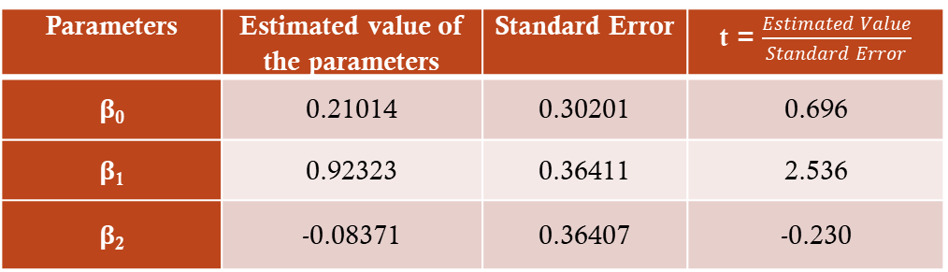
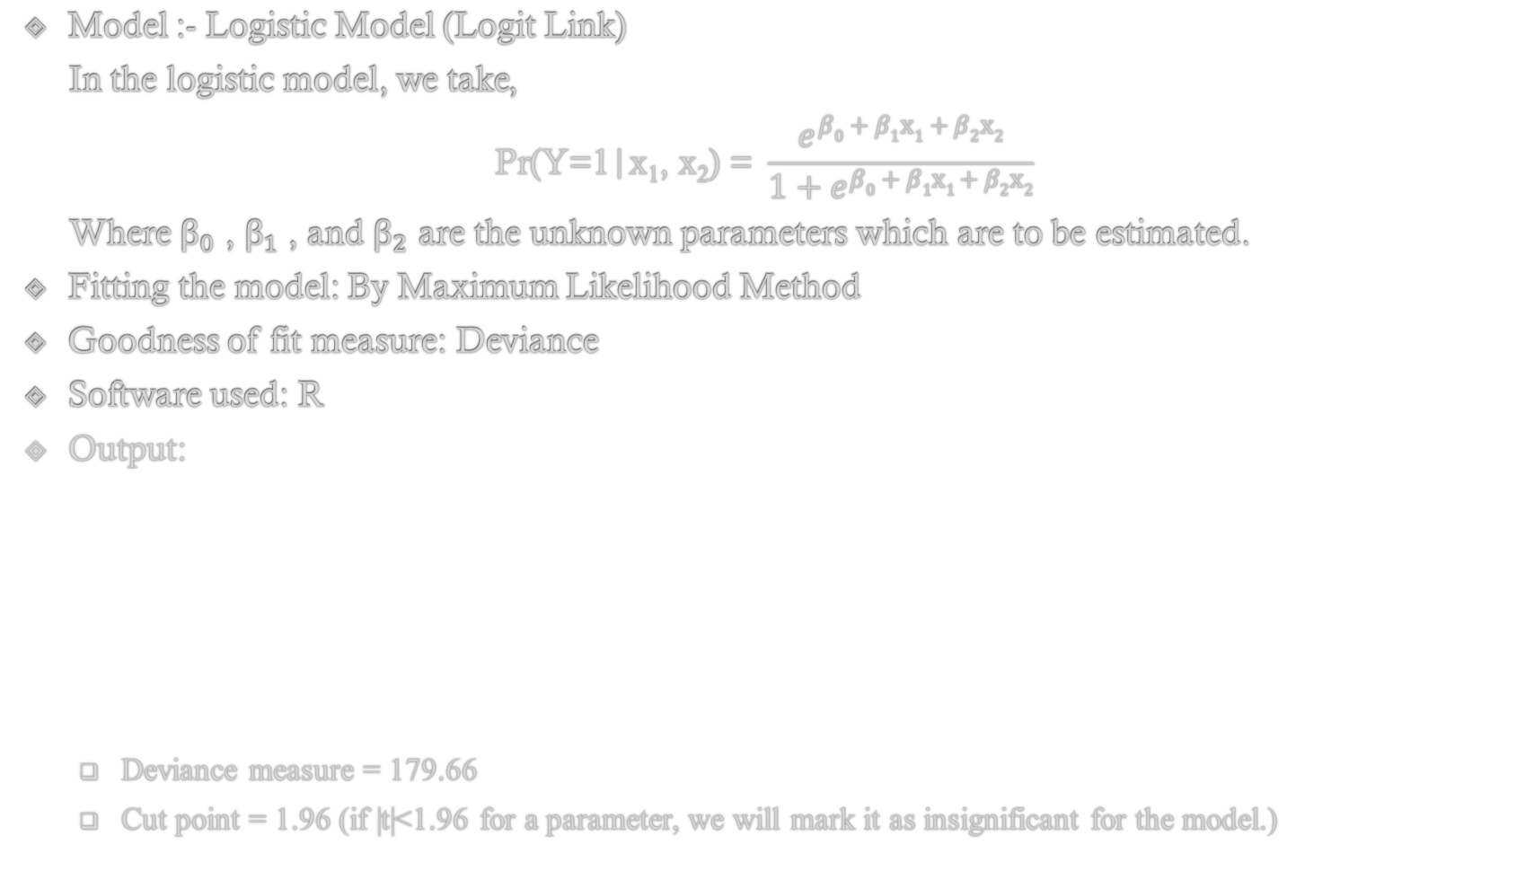
Model Definition and Output
Model :- Logistic Model (Logit Link)
In the logistic model, we take,
$$\text{Pr}\text{(}\text{Y}\text{=1}\text{|}\text{x}\text{1}\text{, }\text{x}\text{2}\text{) = }\frac{e^{β0 + β1x1 + β2x2}}{1+e^{β0 + β1x1 + β2x2}}$$
Where ${\text{β}}_{0}$ , ${\text{β}}_{1}$ , and ${\text{β}}_{2}$ are the unknown parameters which are to be estimated.
Fitting the model: By Maximum Likelihood Method
Goodness of fit measure: Deviance
Software used: R
Output:
Deviance measure = 179.66
Cut point = 1.96 (if |t|<1.96 for a parameter, we will mark it as insignificant for the model.)
Parameters | Estimated value of the parameters | Standard Error | t = $\frac{Estimated Value}{Standard Error}$
β₀ | 0.21014 | 0.30201 | 0.696
β₁ | 0.92323 | 0.36411 | 2.536
β₂ | -0.08371 | 0.36407 | -0.230

Slide 12

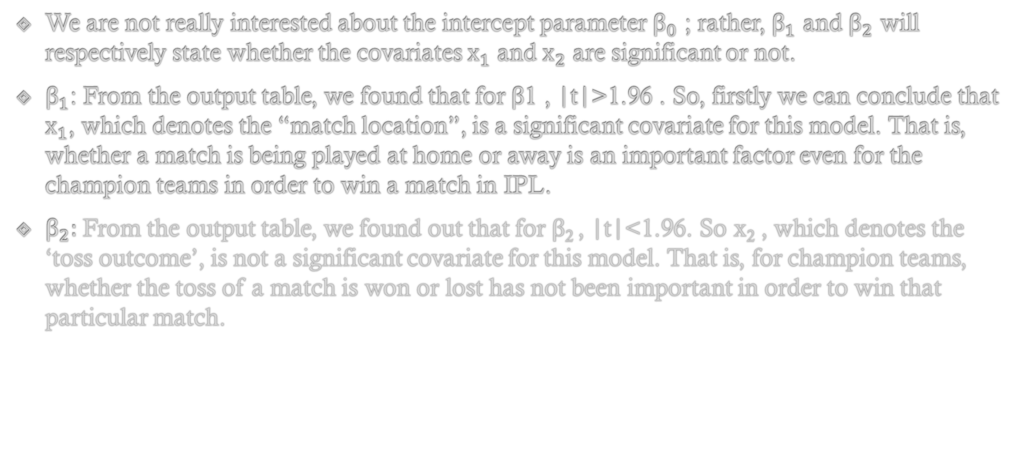
Interpretation
We are not really interested about the intercept parameter ${\text{β}}_{0}$ ; rather, ${\text{β}}_{1}$ and ${\text{β}}_{2}$ will respectively state whether the covariates ${\text{x}}_{1}$ and ${\text{x}}_{2}$ are significant or not.
${\text{β}}_{1}$: From the output table, we found that for β1 , |t|>1.96 . So, firstly we can conclude that ${\text{x}}_{1}$, which denotes the “match location”, is a significant covariate for this model. That is, whether a match is being played at home or away is an important factor even for the champion teams in order to win a match in IPL.
${\text{β}}_{2}:$From the output table, we found out that for β₂ , |t|<1.96. So x­₂ , which denotes the ‘toss outcome’, is not a significant covariate for this model. That is, for champion teams, whether the toss of a match is won or lost has not been important in order to win that particular match.

Slide 13
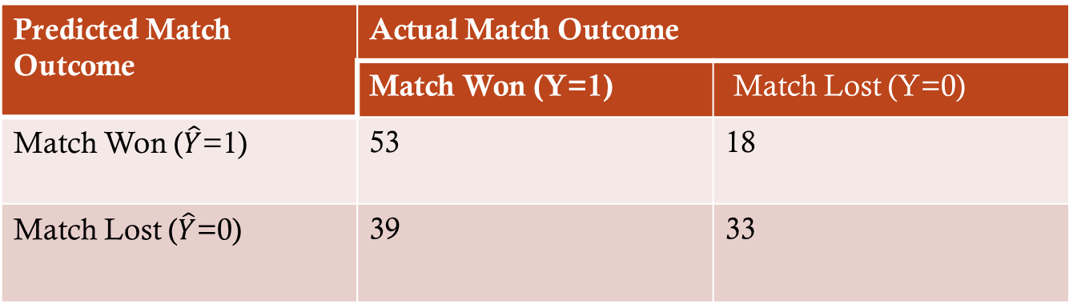
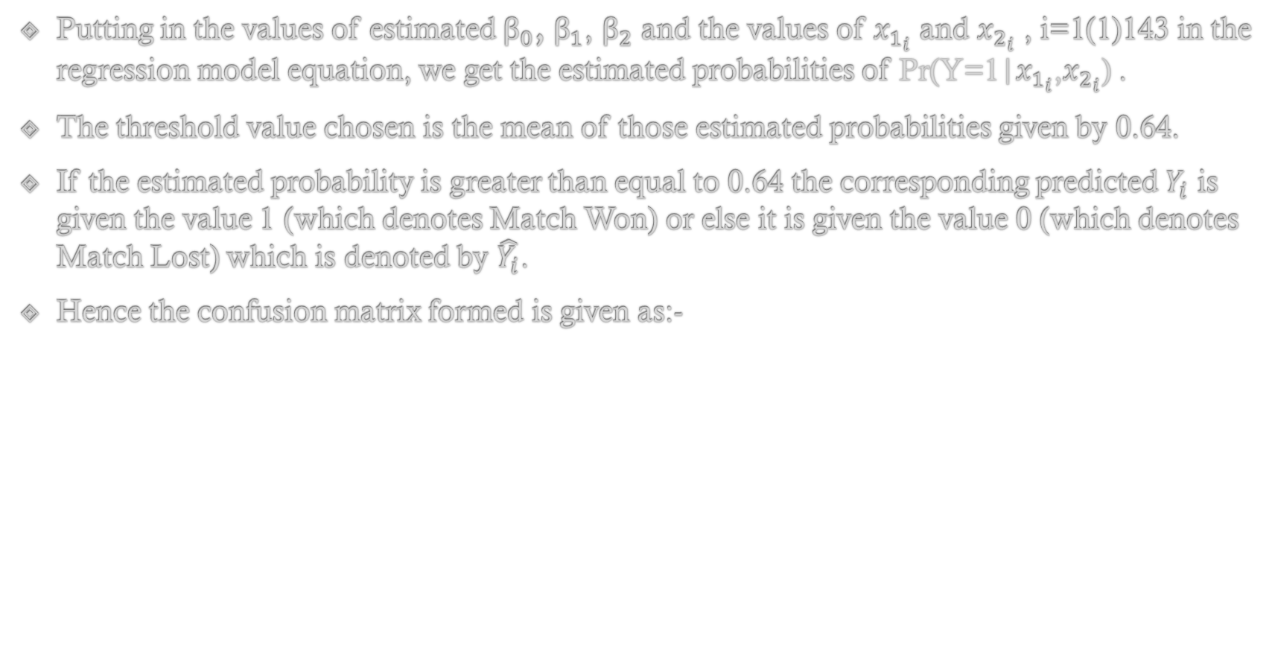
Checking Model Accuracy
Putting in the values of estimated ${\text{β}}_{0}$, ${\text{β}}_{1}$, ${\text{β}}_{2}$ and the values of $x_{1_{i}}$ and $x_{2_{i}}$ , i=1(1)143 in the regression model equation, we get the estimated probabilities of $\text{Pr}\text{(}\text{Y}\text{=1}\text{|}x_{1_{i}}\text{,}x_{2_{i}}\text{) }$.
The threshold value chosen is the mean of those estimated probabilities given by 0.64.
If the estimated probability is greater than equal to 0.64 the corresponding predicted $Y_{i}$ is given the value 1 (which denotes Match Won) or else it is given the value 0 (which denotes Match Lost) which is denoted by $\hat{Y_{i}}$.
Hence the confusion matrix formed is given as:-
Predicted Match Outcome | Actual Match Outcome
 | Match Won (Y=1) | Match Lost (Y=0)
Match Won ($\hat{Y}$=1) | 53 | 18
Match Lost ($\hat{Y}$=0) | 39 | 33

Slide 14
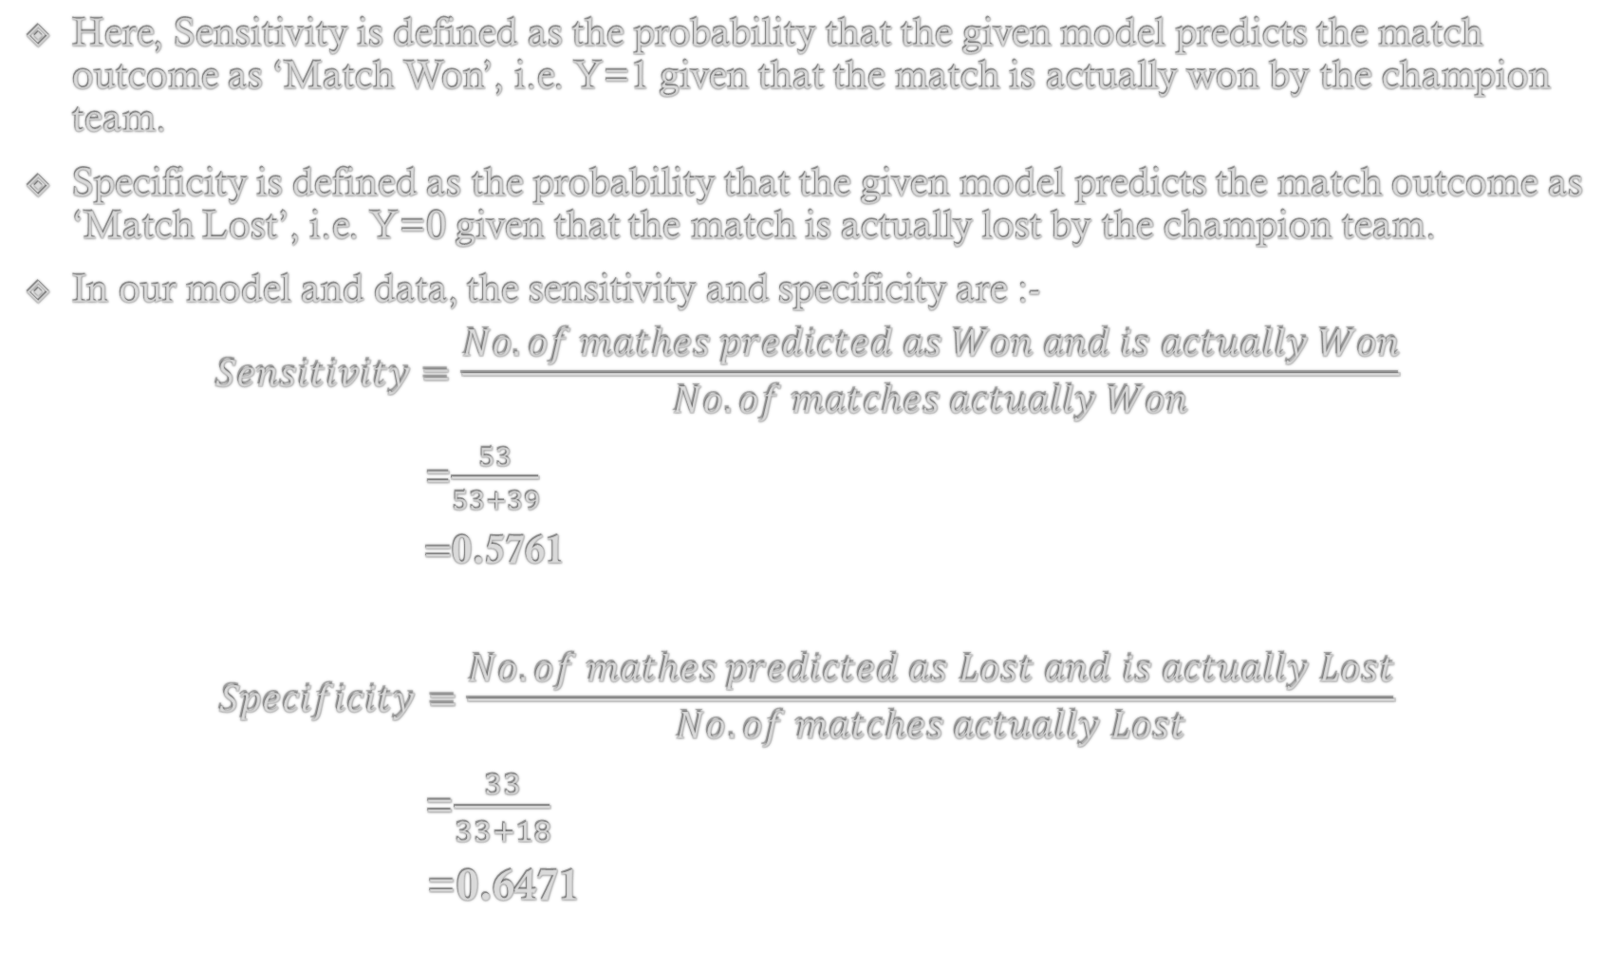
Here, Sensitivity is defined as the probability that the given model predicts the match outcome as ‘Match Won’, i.e. Y=1 given that the match is actually won by the champion team.
Specificity is defined as the probability that the given model predicts the match outcome as ‘Match Lost’, i.e. Y=0 given that the match is actually lost by the champion team.
In our model and data, the sensitivity and specificity are :-
$$Sensitivity=\frac{No. of mathes predicted as Won and is actually Won}{No. of matches actually Won}$$
=$\frac{53}{53+39}$
$=$0.5761
$$Specificity=\frac{No. of mathes predicted as Lost and is actually Lost}{No. of matches actually Lost}$$
=$\frac{33}{33+18}$
=0.6471

Slide 15

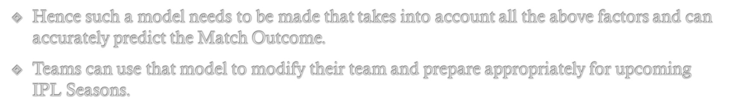
Conclusion
We found the sensitivity and specificity to be 0.5761 and 0.6471 respectively which aren’t that high.
Hence the regression model is not that accurate in predicting the match outcome.
There can be three reasons for this:-
We found the Match Location to be significant but Toss Outcome to be insignificant in predicting the Match Outcome. This makes the model kind of a one to one relationship between the Match Location and Match Outcome which is not an appropriate model.
Other factors such as team selection, pitch condition, dew, batting first/bowling first, etc. affect the Match Outcome and may need to be added to the model.
The model it self may not be a logit link model and a different type of non-linear regression model may be required.

Slide 16

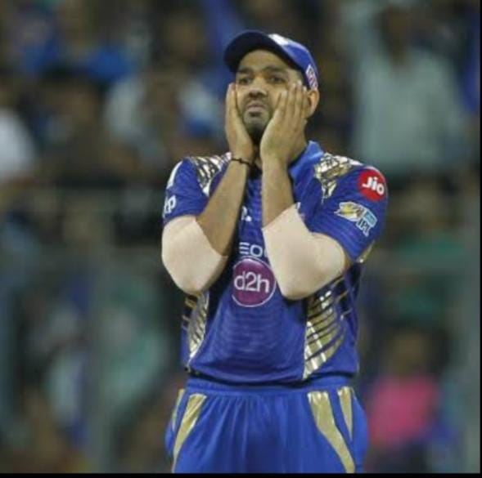


Slide 17
References
Goon A.M., Gupta M.K., Dasgupta, B. (2005), Fundamentals of Statistics, Vol II, World Press, Calcutta.
Agresti, A. (2007), An Introduction to Categorical data analysis. Wiley.
Data was collected manually from Wikipedia.
https://vitalflux.com/ml-metrics-sensitivity-vs-specificity-difference/
https://medium.com/fintechexplained/sensitivity-vs-specificity-in-data-science-2f673039dbd1
Archana Ma’ams Notes.

Slide 18
Thank You!
Hope your favourite IPL team doesn’t win next season and one of ours do!

